Slide 1
The Physics-informed AI Climate Model Agent Neuro-symbolic Simulator (PACMANS) for Tipping Point Discovery DARPA Kickoff Meeting 12/15/2021
Jennifer Sleeman, Ph.D.
Jay Brett, Ph.D.
Marisa Hughes, Ph.D.
Anand Gnanadesikan, Ph.D.
Yannis Kevrekidis, Ph.D.
DISTRIBUTION STATEMENT A: Approved for public release: distribution unlimited.

Slide 2
Overview
Motivation
AMOC
PACMANs Overview
Team Introduction
Approach
Data/Evaluation
Questions

Slide 3
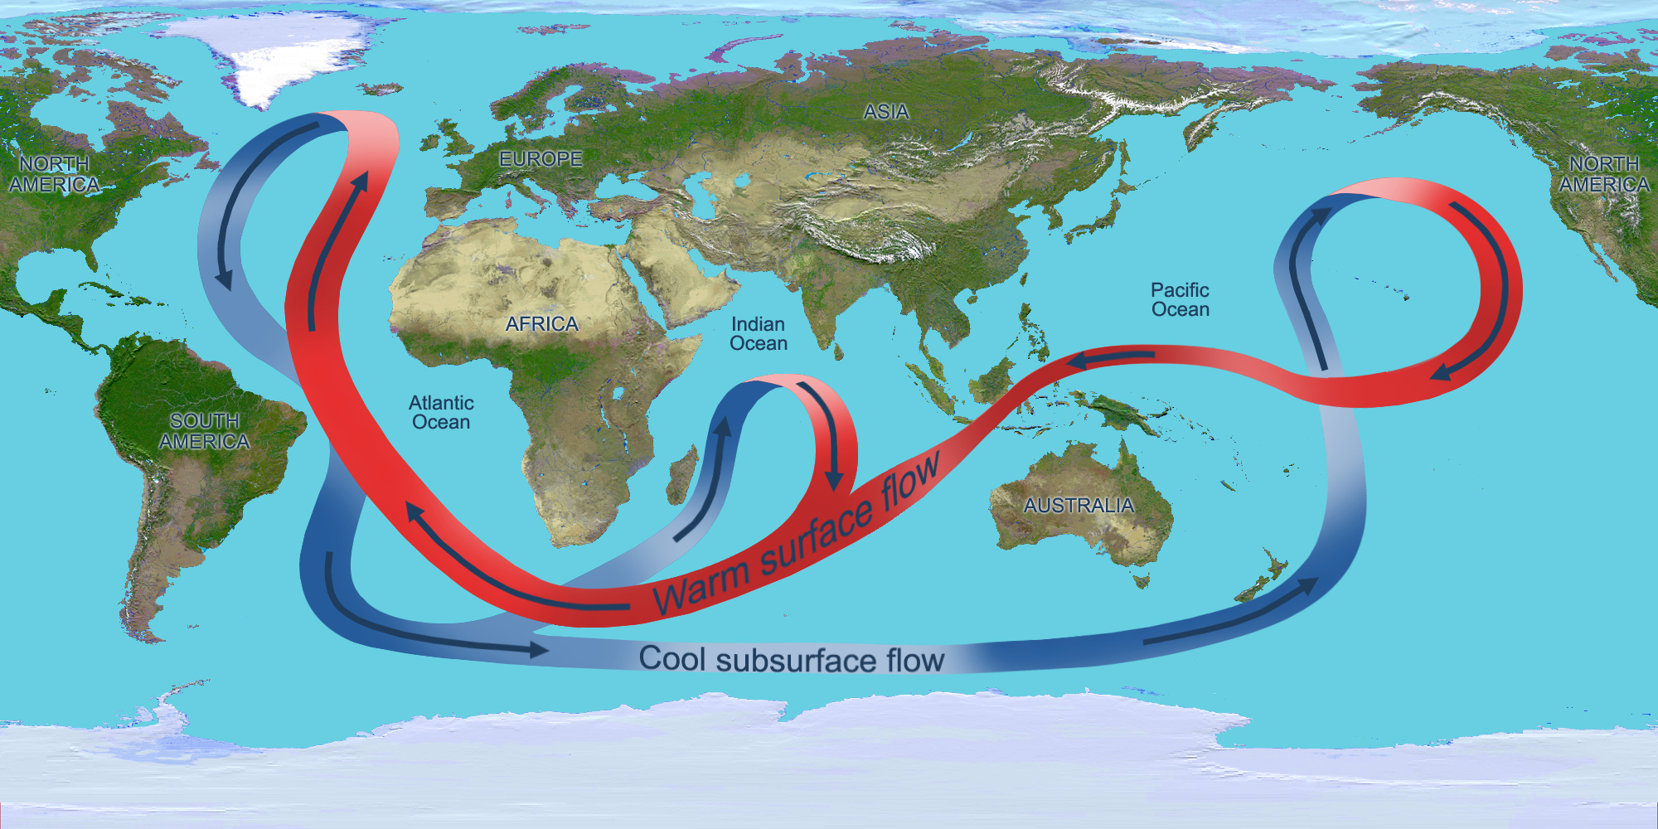
Motivation
Boers (2021) described the global effects of the instability of the Atlantic Meridional Overturning Circulation (AMOC)
Almost complete loss of stability could have devastating effects on:
food security,
rising sea levels,
arctic related effects and
vulnerable ecosystems
The AMOC (NASA)
Due to the dire effects (that are known) of a complete instability of the AMOC, there is a strong sense of urgency in both understanding and identifying the AMOC tipping point

Slide 4
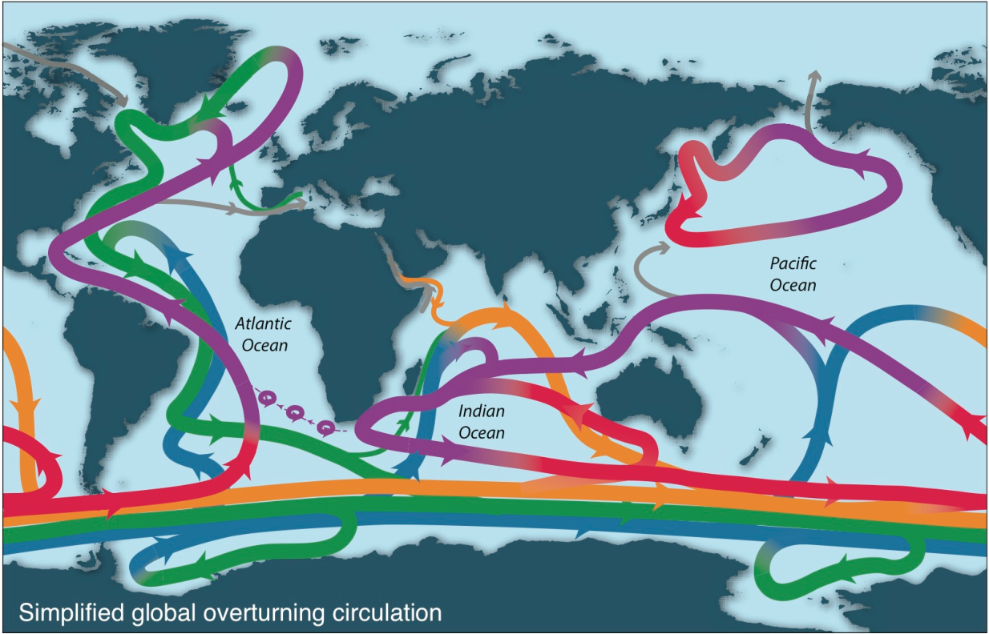
The AMOC: Ocean convection and overturning
Density difference between 1000m and surface
Schematic of overturning (Talley, 2013)
Deep circulation (green/dark blue) driven by very small regions! But has major impact on heat, carbon, and oxygen.
Only a few regions are near zero

Slide 5


The AMOC: Occurrence of convection is balanced between
Positive forcings:
Warming of low latitudes
Cooling of high latitudes
Upwelling in subpolar gyre (+North Atlantic Oscillation/Arctic Oscillation?)
Lateral mixing of salinity by eddies into the mixed layer
Stronger winds driving more evaporation
Negative forcings:
Hydrological cycle, salinifies tropics and freshens high latitudes
Warming of high latitudes
Weak downwelling in subpolar gyre (-NAO/AO?)
Lateral advection by eddies
Weaker winds driving less evaporation

Slide 6
The AMOC: But balances differ in different models
Atlantic overturning streamfunction in Sv
Sensitivity of convection/overturning depends on parameters
(note difference between colors)
Sign of change under increased CO2 also depends on overturning
Low lateral mixing
High lateral mixing
Solid: Preindustrial
Dashed: 2xCO2
Low lateral mixing
High lateral mixing
Associated differences in interaction of convective plumes with oceanic dead zones (low-oxygen waters) give opposite sign changes under global warming.
Bahl, Gnanadesikan and Pradal, GBC, 2019

Slide 7
AMOC Climate Modeling Challenges
Ocean data is sparse
Historical records limited mainly to ship tracks
biases data to Northern hemisphere
Satellites and autonomous floats increase available data
Still limited to the surface for satellites and to a sparse array of locations with drifters
Computational Limitations
Asking questions of the model prohibitive

Slide 8
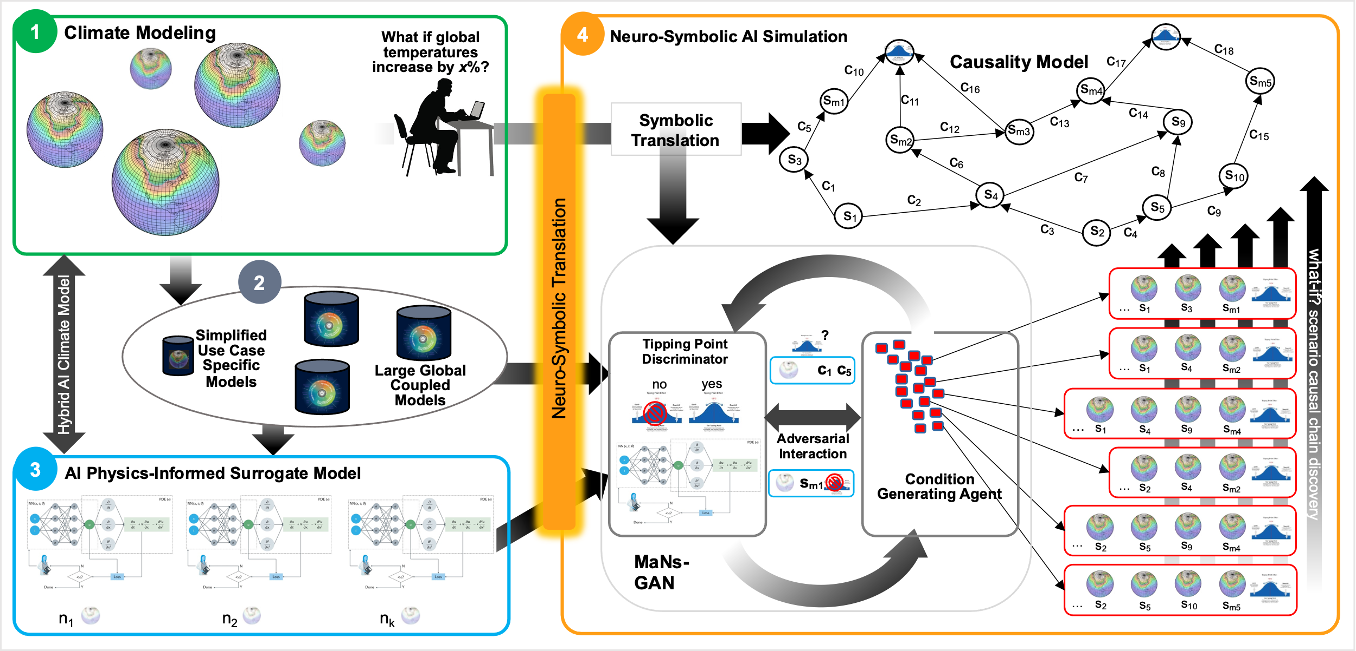
PACMANs
The Physics-informed AI Climate Model Agent Neuro-symbolic Simulator (PACMANS) for Tipping Point Discovery Framework.

Slide 9
Goals:
Build a new climate tipping point dataset for AI exploration
Reduce computations of large climate model ensembles that prohibit asking questions of the models pertaining to tipping point studies
Create a proof-of-concept climate neuro-symbolic language to represent problems that map modeler-specific problems into a symbolic representation that can be reasoned upon
Extend Kevrekidis’ work that enables tipping point discovery for coarse surrogate models using bifurcation and use it for neural unsupervised exploration
Use the neuro-symbolic language and neural exploration to build causal paths that can be reasoned upon and provide AI explainability
Apply this methodology to the AMOC use case

Slide 10
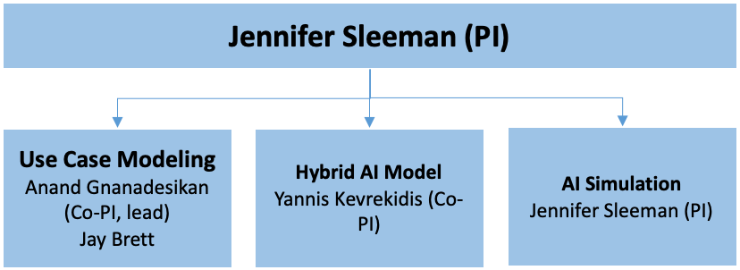
The Team
PI: Dr. Jennifer Sleeman (AI) – JHU/APL
Key Personnel: Dr. Jay Brett (Climate Modeling) – JHU/APL
Subcontract Co-PI: Dr. Anand Gnanadesikan (Climate Modeling) - JHU
Subcontract Co-PI: Dr. Yannis Kevrekidis (AI and Numeric Modeling) - JHU
APL Program Manager: Dr. Marisa Hughes – JHU/APL

Slide 11
More About the Team
Dr. Jennifer Sleeman (JHU APL PI; AI Simulation Group) is a Senior Machine Learning Researcher in APL’s Artificial Intelligence Group with over 20 years of experience as an AI researcher, with a focus on climate science, weather and artificial intelligence using deep learning for various weather pollution projects. Dr. Sleeman is the PI of a grant with NOAA to emulate the transport of chemicals and aerosols using AI for NOAA air quality forecast guidance. She has recently published work related to a physics-inspired AI edge detection method (SPIE 2021) for identifying the planetary boundary layer, funded through NASA. She holds a patent in Deep Model Translation and Generation, and has been a major research contributor in the area of deep learning for image recognition, knowledge representation and NLP. She effectively brings together team members of diverse technical backgrounds to address challenging multidisciplinary research problems and will lead the PACMANS effort, as well as the AI research groups. She will apply her expertise in GANs and her expertise in knowledge and reasoning to support the AI simulation effort.
Dr. Anand Gnanadesikan (JHU Co-PI; Lead of Use Case Modeling Group) is an Earth System Modeler who works on the interactions between ocean circulation and atmosphere, biosphere and cryosphere. Before coming to JHU, he spent 15 years at the NOAA Geophysical Fluid Dynamics Lab, helping improve the representation of physics and biochemical cycling within Earth System Models. He has worked extensively on the physics responsible for setting the magnitude of the AMOC, demonstrating its long-term connection with the Southern Ocean. He has also looked how changes in convection in the North Pacific and Southern Ocean depend on eddy mixing and affect oceanic biology. Other notable team members: Dr. Tom Haine and Marie-Aude Pradal
Dr. Yannis Kevrekidis (JHU Co-PI; Physics-Informed Surrogate Model Group), a Bloomberg Distinguished Professor of Applied Mathematics and Statistics, and of Chemical and Biomolecular Engineering, is an applied mathematician/computational engineer with forty years expertise in nonlinear dynamics, data driven modeling (machine learning, manifold learning) and multiscale modeling, with an interface between traditional modeling and ML/neural network-based modeling in physics-informed data driven models. He has extensive expertise in the machine learning of tipping points for agent-based models and has served as a DARPA PI. He will provide theoretical expertise for physics-informed surrogate modeling and support tipping point characterization.
Dr. Jay Brett (JHU APL Use Case Modeling, Evaluation, and Data Acquisition Groups) is a Senior Oceanographer in APL’s Oceanic, Atmospheric, and Remote Sensing Sciences Group with expertise in numerical modeling of physical and biological processes of the ocean. Dr. Brett studied physical oceanography in the Massachusetts Institute of Technology-Woods Hole Oceanographic Institution Joint Program and will provide ocean physical modeling expertise to the Use Case Modeling, Evaluation, and Data Acquisition groups.
Additional Support: Dr. Grey Nearing, Assistant Professor at UC Davis University and will be providing expertise in the area of hydrology and machine learning as an unfunded collaborator.
Additional APL staff members in APL’s Intelligent Systems Center (ISC) with expertise in causal modeling (Dr. Joshua T. Brule) and neuro-symbolic AI (Dr. Alex Memory) will also support this effort.
Dr. Marisa Hughes (JHU APL Program Manager) leads the programs related to environmental resilience and has experience in earth systems, intelligence, missile defense, health, neuroscience, and submarine maintenance domains.

Slide 12
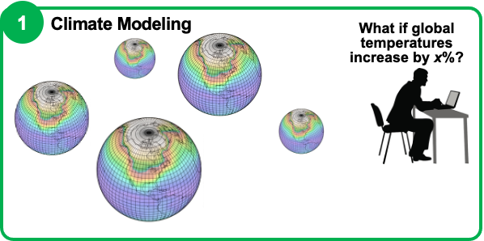
AMOC Tipping Point Climate Modeling
Explore drivers:
the role of surface winds and fluxes
how declines in the AMOC can build to a complete shut-off, and
the causes preventing recovery from a specific decline
Using targeted general circulation models (GCMs) run by JHU for detailed exploration of ocean currents
This exploration will be studied and used for building the AI models

Slide 13
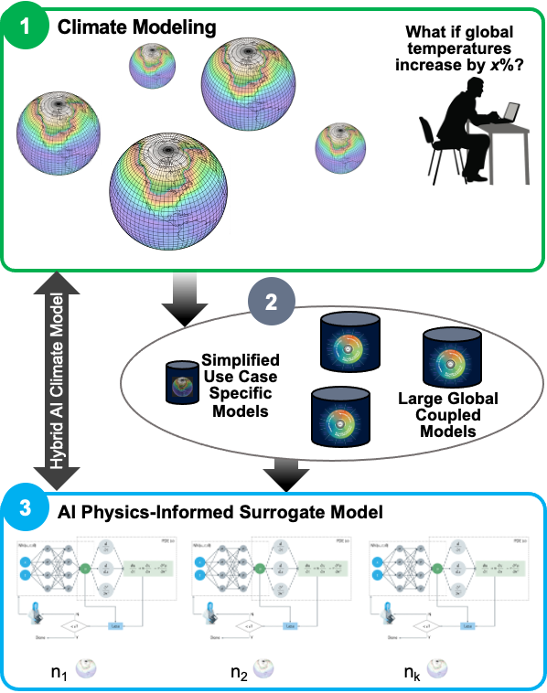
AI Surrogate Climate Modeling
Coarse surrogate models trained offline
Reduced set of models focused on areas around tipping points
Trained to learn tipping points using coarse bifurcation signatures
CMIPs and targeted GCMs model datasets will be used with the surrogate models
Trained surrogates will be used by the AI simulation
AI models will be based on current research by Sleeman/NOAA [28] and work by Kevrekidis [8] using physics-informed (grey box) algorithms

Slide 14
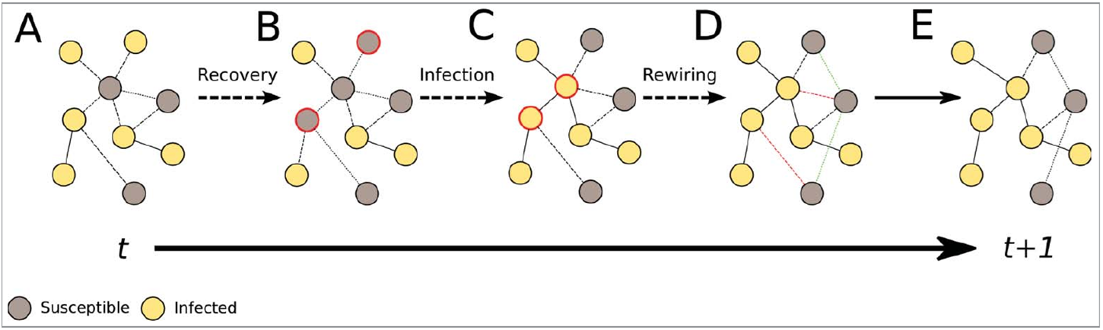
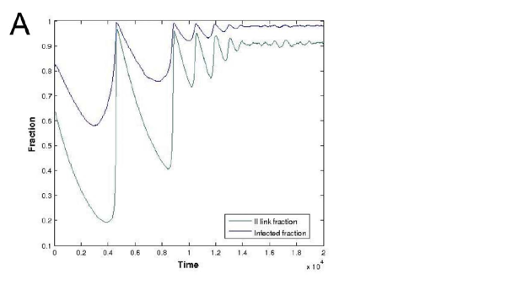
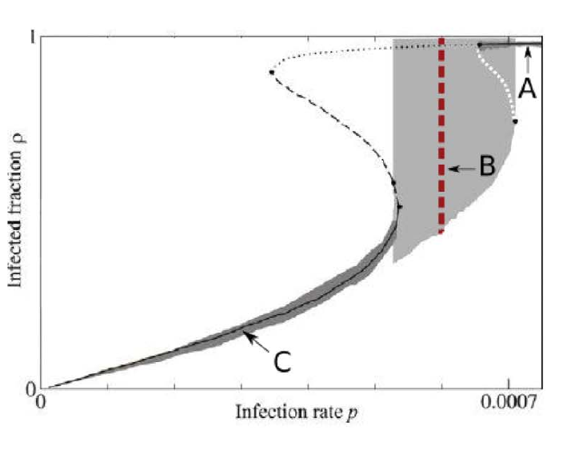
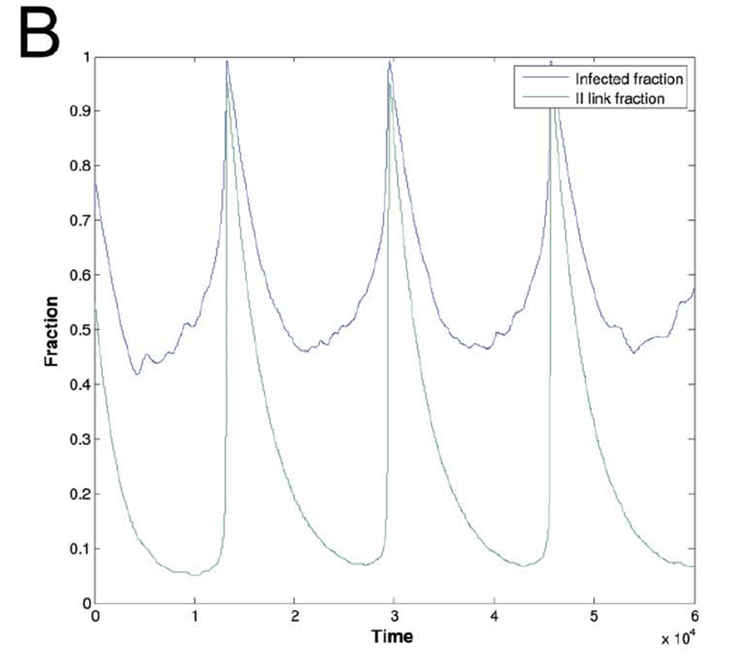
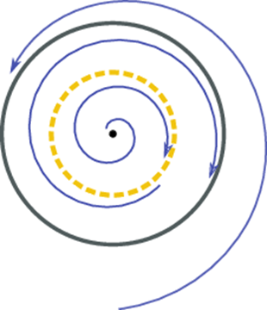
Targeted Tipping Point Surrogates: An adaptive network dynamics example, Virulence, 2016
Coarse Tipping Point Signature: Subcritical Hopf

Slide 15
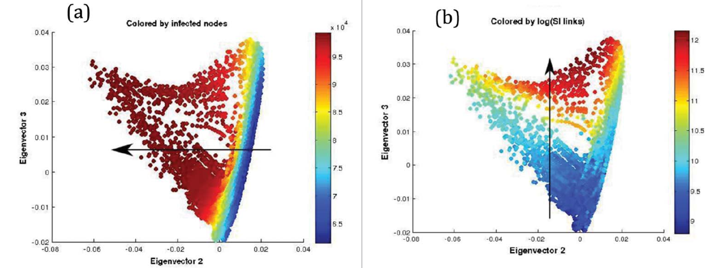
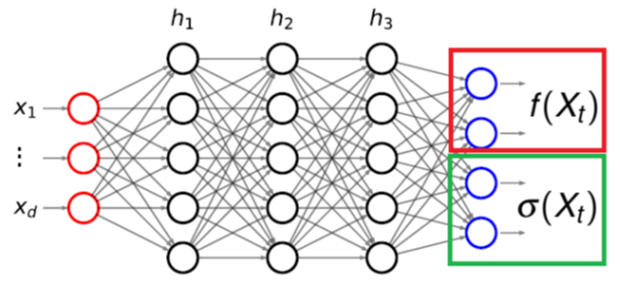
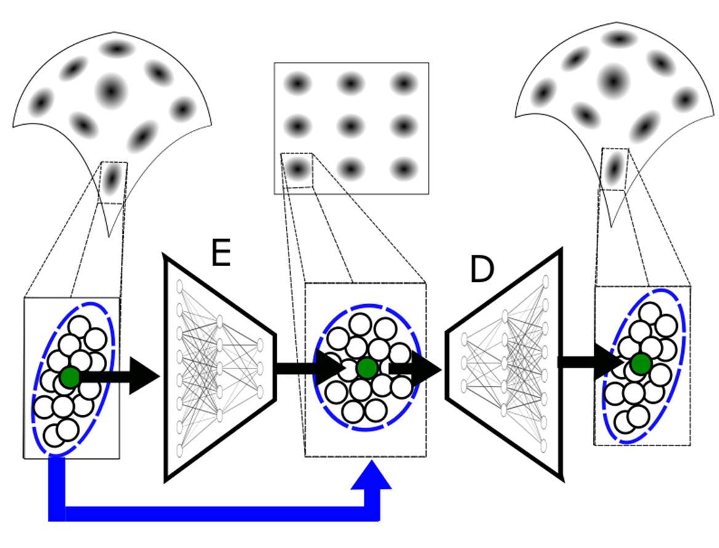
ML: Dmap Observables, Interpretability, ANNs for Effective SDE surrogates, Rare Event Computations, Data Fusion/Model Calibration

Slide 16
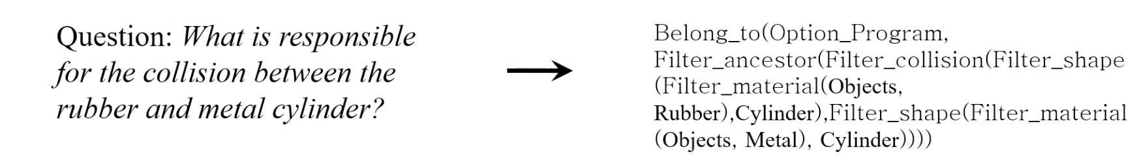
Neuro-Symbolic Language
Building on early successes in [20,32]
Similar to how objects in a scene are represented (size, texture, color)
Will symbolically represent a subset of climate elements, events
Enables natural question symbolic representation
Example symbolic representation of a question from Mao [32].

Slide 17
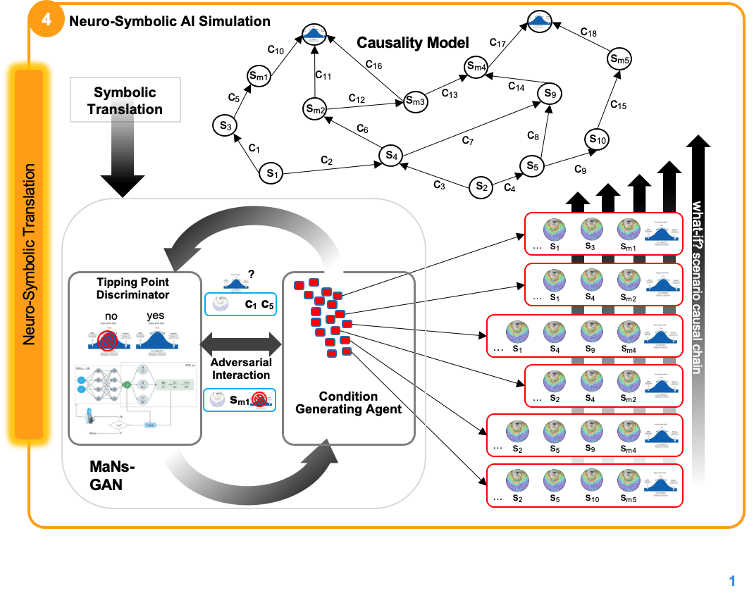
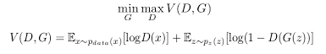
Neuro-Symbolic AI Simulation
Multi-agent neuro-symbolic generative adversarial network (MaNs-GAN)
Adversarial game between a set of generating agents to explore parameter space and tipping point discriminative model
Generators learn to manipulate conditions to reach tipping point states
Discriminator uses surrogate models to discover, classify tipping point states

Slide 18
Neuro-Symbolic AI Simulation
*Surrogate model need not be a specific type
surrogate_model (condition_set C)
Surrogate
TP₁(surrogate_model, condition_set C)
where c₁∈ C and c₁ = [flux of water to subpolar Atlantic basin, v_{m}]
Run model with c..c_{n} conditions
Generator_{1a}
2
Probability of Tipping point based on Surrogate feedback?
change conditions
for a tipping point?
Discriminator
1
Generator₁
Generator_{1b}
Tipping Point
Identifier
3
Adversarial Interaction
6
4
Generator_{1c}
Tipping point
no
…
Known to the discriminator:
TP₁([flux of water to subpolar Atlantic basin, >, v₁],…[c_{n},..,v])
5
Tipping point
yes
Vary conditions and run
Generator^{1..x}
How else to nudge?
Evaluate
Surrogate
4
Surrogate
causal model cg₁ representing the state of TP1 with root node as the surrogate model
TP₁(surrogate_model, C)
TP₁No, => try different condition nudges

Slide 19
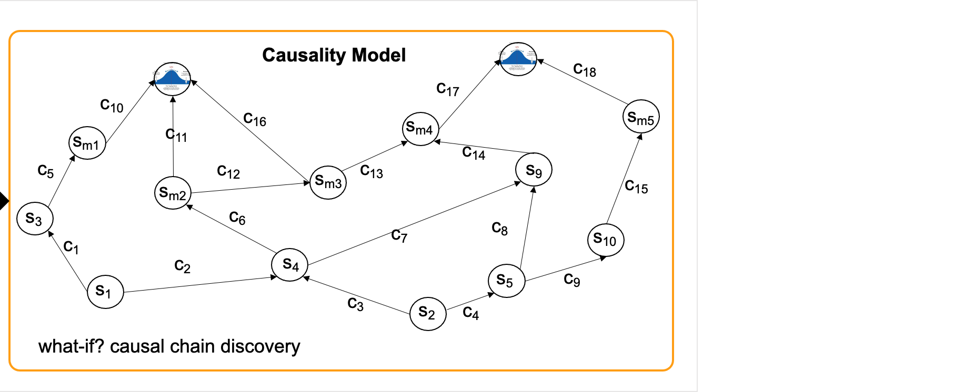
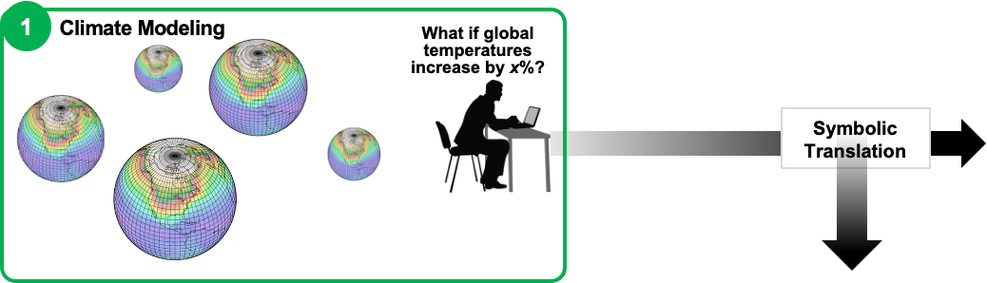
Causal Model
Adversarial game results in explored tipping points paths
Represented symbolically for causal reasoning (Inspired by CausalGAN Kocaoglu et al. [18])
Causal model will be used to reduce parameter space of large climate models and reasoned upon for discovery of new paths using methods developed by team member Brule [11]
Translated back to modeler using the neuro-symbolic translation layer for explainability
Benefit for Climate Modeling: Reduces the parameter search space to sets that will have high probability of a tipping point

Slide 20
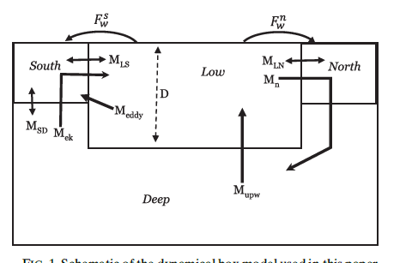
Surrogate Climate Models for Evaluation
On long time scales, Atlantic overturning can often be described by simple box model…
… which exhibits tipping points.
But work needs to be done to
Extend to include Pacific Basin
Calibrate model against specific climate models (NCAR+CMIP6) using preindustrial and historical simulations.
Show that model can capture both mean state and variability
Use surrogate model to project tipping points, examine for accuracy of prediction.
Gnanadesikan, 1999; Gnanadesikan, Kelson and Sten, J. Climate 2018

Slide 21
Tipping Point Generation Strategy
Run ensemble where radiative forcing increases linearly over time.
Branch off at various points and continuously decrease forcing.
Tipping point detection: Look for changes that are reversible up to some point, not reversible beyond that point
Compare this behavior in surrogate/hybrid models and full GCMs (start with NCAR).
If timing is different across ensembles, look for common precursors (fingerprint detection).
Radiative forcing
Time

Slide 22
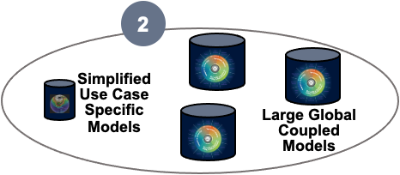
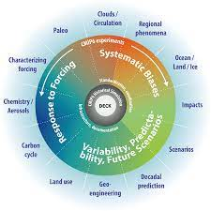
The Data
AI models will be trained using Sixth Coupled Model Intercomparison Project (CMIP6) [25] based datasets (custom built)
Targeted general circulation models (GCMs) developed by JHU related to ocean currents
Specific logic used in the JHU box models for identifying tipping points will be used to train AI models (see later discussion on evaluation)

Slide 23
Data Specifics for Experimental Setup
Specific datasets from large global coupled models to explore AMOC drivers and possible tipping points:
1) Abrupt 4xCO_2 experiments, which show a wide range of AMOC declines and associated climate outcomes [29]
2) Models (4 in CMIP6, 9 in CMIP5) with abrupt cooling in the North Atlantic in forward scenarios, to examine realistic time-dependence and feedbacks [30-31]

Slide 24
Thank you and Questions
We are excited about the prospect of this study
We look forward to collaborating with the group
Thank you and we will take questions at this point.

Slide 25
Citations
1. Boers, Niklas. "Observation-based early-warning signals for a collapse of the Atlantic Meridional Overturning Circulation." Nature Climate Change 11, no. 8 (2021): 680-688.
2. Gnanadesikan, A., A simple model for the structure of the oceanic pycnocline, Science., 283:2077-2079, (1999).
3. Forget, G., J.-M. Campin, P. Heimbach, C. N. Hill, R. M. Ponte, C. Wunsch, ECCO version 4: An integrated framework for non-linear inverse modeling and global ocean state estimation. Geosci. Model Dev. 8, 3071–3104 (2015)
4. Gnanadesikan, A., R. Kelson and M. Sten, Flux correction and overturning stability: Insights from a dynamical box model, J. Climate, 31, 9335-9350, https://doi.org/10.1175/JCLI-D-18-0388.1, (2018).
5. Kaufhold, John Patrick, and Jennifer Alexander Sleeman. "Systems and methods for deep model translation generation." U.S. Patent No. 10,504,004. 10 Dec. 2019.
6. Garcez, Artur d'Avila, and Luis C. Lamb. "Neurosymbolic AI: the 3rd Wave." arXiv preprint arXiv:2012.05876 (2020).
7. Stommel, H. Thermohaline convection with two stable regimes of flow. Tellus 13, 224–230 (1961).
8. Karniadakis, George Em, Ioannis G. Kevrekidis, Lu Lu, Paris Perdikaris, Sifan Wang, and Liu Yang. "Physics-informed machine learning." Nature Reviews Physics 3, no. 6 (2021): 422-440.
9. Sleeman, Jennifer, Milton Halem, Zhifeng Yang, Vanessa Caicedo, Belay Demoz, and Ruben Delgado. "A Deep Machine Learning Approach for LIDAR Based Boundary Layer Height Detection." In IGARSS 2020-2020 IEEE International Geoscience and Remote Sensing Symposium, pp. 3676-3679. IEEE, 2020.
10. Patel, Kinjal, Jennifer Sleeman, and Milton Halem. "Physics-aware deep edge detection network." In Remote Sensing of Clouds and the Atmosphere XXVI, vol. 11859, pp. 32-38. SPIE, 2021.
11.Brulé, Joshua. "A causation coefficient and taxonomy of correlation/causation relationships." arXiv preprint arXiv:1708.05069 (2017).
12. Rasp, Stephan, Michael S. Pritchard, and Pierre Gentine. "Deep learning to represent subgrid processes in climate models." Proceedings of the National Academy of Sciences 115, no. 39 (2018): 9684-9689.
13. Bolton, Thomas, and Laure Zanna. "Applications of deep learning to ocean data inference and subgrid parameterization." Journal of Advances in Modeling Earth Systems 11, no. 1 (2019): 376-399.
14. Kurth, Thorsten, Sean Treichler, Joshua Romero, Mayur Mudigonda, Nathan Luehr, Everett Phillips, Ankur Mahesh et al. "Exascale deep learning for climate analytics." In SC18: International Conference for High Performance Computing, Networking, Storage and Analysis, pp. 649-660. IEEE, 2018.

Slide 26
Citations cont.
15. Weber, Theodore, Austin Corotan, Brian Hutchinson, Ben Kravitz, and Robert Link. "Deep learning for creating surrogate models of precipitation in Earth system models." Atmospheric Chemistry and Physics 20, no. 4 (2020): 2303-2317.
16. Matsubara, Takashi, Ai Ishikawa, and Takaharu Yaguchi. "Deep energy-based modeling of discrete-time physics." arXiv preprint arXiv:1905.08604 (2019).
17. Kleinen, T., Held, H. & Petschel-Held, G. The potential role of spectral properties in detecting thresholds in the Earth system: application to the thermohaline circulation. Ocean Dyn. 53, 53–63 (2003).
18. Kocaoglu, Murat, Christopher Snyder, Alexandros G. Dimakis, and Sriram Vishwanath. "Causalgan: Learning causal implicit generative models with adversarial training." arXiv preprint arXiv:1709.02023 (2017).
19. Feinman, Reuben, and Brenden M. Lake. "Learning Task-General Representations with Generative Neuro-Symbolic Modeling." arXiv preprint arXiv:2006.14448 (2020).
20. Yi, Kexin, Chuang Gan, Yunzhu Li, Pushmeet Kohli, Jiajun Wu, Antonio Torralba, and Joshua B. Tenenbaum. "Clevrer: Collision events for video representation and reasoning." arXiv preprint arXiv:1910.01442 (2019).
21. Nowack, Peer, Jakob Runge, Veronika Eyring, and Joanna D. Haigh. "Causal networks for climate model evaluation and constrained projections." Nature communications 11, no. 1 (2020): 1-11.
22. Andersson, Tom R., J. Scott Hosking, María Pérez-Ortiz, Brooks Paige, Andrew Elliott, Chris Russell, Stephen Law et al. "Seasonal Arctic sea ice forecasting with probabilistic deep learning." Nature communications 12, no. 1 (2021): 1-12.
23. Storchan, Victor, Svitlana Vyetrenko, and Tucker Balch. "MAS-GAN: Adversarial Calibration of Multi-Agent Market Simulators." (2020).
24. De Raedt, Luc, Robin Manhaeve, Sebastijan Dumancic, Thomas Demeester, and Angelika Kimmig. "Neuro-symbolic=neural+ logical+ probabilistic." In NeSy'19@ IJCAI, the 14th International Workshop on Neural-Symbolic Learning and Reasoning. 2019.
25. Eyring, V., Bony, S., Meehl, G. A., Senior, C. A., Stevens, B., Stouffer, R. J., and Taylor, K. E.: Overview of the Coupled Model Intercomparison Project Phase 6 (CMIP6) experimental design and organization, Geosci. Model Dev., 9, 1937-1958, doi:10.5194/gmd-9-1937-2016, 2016.
26. Swingedouw, Didier, Chinwe Ifejika Speranza, Annett Bartsch, Gael Durand, Cedric Jamet, Gregory Beaugrand, and Alessandra Conversi. "Early warning from space for a few key tipping points in physical, biological, and social-ecological systems." Surveys in geophysics 41, no. 6 (2020): 1237-1284.
27. Reichstein, Markus, Gustau Camps-Valls, Bjorn Stevens, Martin Jung, Joachim Denzler, and Nuno Carvalhais. "Deep learning and process understanding for data-driven Earth system science." Nature 566, no. 7743 (2019): 195-204.

Slide 27
Citations cont.
28. Sleeman, Jennifer, Ivanka Stajner, Christoph Keller, Milton Halem, Christopher Hamer, Raffaele Montuoro, and Barry Baker. "The Integration of Artificial Intelligence for Improved Operational Air Quality Forecasting." In AGU Fall Meeting 2021. 2021.
29. Bellomo, K., Angeloni, M., Corti, S. et al. Future climate change shaped by inter-model differences in Atlantic meridional overturning circulation response. Nat Commun 12, 3659 (2021). https://doi.org/10.1038/s41467-021-24015-w
30. Sgubin, G., Swingedouw, D., Drijfhout, S. et al. Abrupt cooling over the North Atlantic in modern climate models. Nat Commun 8, 14375 (2017). https://doi.org/10.1038/ncomms14375
31. Swingedouw, D., Bily, A., Esquerdo, C., Borchert, L. F., Sgubin, G., Mignot, J., & Menary, M. (2021). On the risk of abrupt changes in the North Atlantic subpolar gyre in CMIP6 models. Annals of the New York Academy of Sciences, 1504(1), 187-201. https://doi.org/10.1111/nyas.14659
32. Mao, Jiayuan, Chuang Gan, Pushmeet Kohli, Joshua B. Tenenbaum, and Jiajun Wu. "The neuro-symbolic concept learner: Interpreting scenes, words, and sentences from natural supervision." arXiv preprint arXiv:1904.12584 (2019).
This material is based upon work supported by the Defense Advanced Research Projects Agency (DARPA) under Agreement No. HR00112290032.

